Slide 1


ONLINE HOTEL MANAGEMENT SYSTEM
Presentation By:- Muthukrishna J.M. Manoj U, Nayana R, Lavanya M, Vanishree S Vidyavahini First Grade College Tumkur.

Slide 2
ONLINE HOTEL MANAGEMENT SYSTEM Under Supervision of : Submitted By: Name : Address : Phone No : Programme : Enrolment No :

Slide 3
TABLE OF CONTENT CHAPTER 1. Abstraction 2. Objectives 3. Project Features 4. Scope of Improvements 5. Scope of Feature Application 6. Advantages 7. ER- Diagram 8. Gallery 9. Function Details 10. Conclusion 11. Bibliography

Slide 4
ABSTRACTION This application is specially developed to help hotel staff. The project Hotel Management manages and maintains the records of customers and room in the hotel. The rooms have different categories such as Deluxe, Semi-Deluxe etc., So their charges and records will be maintained accordingly. * This software has been made in a user friendly interface, so that anyone can add, delete the entries of customers and handle all the transactions easily. As a security we have provided Admin & user level authentication for different modules such as set-up-user etc., also the user name and password gets stored in the database in encrypted format more dealing with the security.

Slide 5
OBJECTIVE During the past several decades personnel function has been transformed from a relatively obscure record keeping staff to central and top level management function. There are many factors that have influenced this transformation like technological advances, professionalism, and general recognition of human beings as most important resources. • The main objective of the entire activity is to automate the process of day to day activities of Hotel like: 1. Room activities, 2. Admission of a New Customer, 3. Assign a room according to customer’s demand, 4. Checkout of a computer and releasing the room 5. Finally compute the bill etc.

Slide 6
PROJECT FEATURES: 1 HOTEL’S ROOM INFORMATION: It provides User to easily search room’s availability, category & easy updating of the room’s records. The room numbers and cost per stay can be changed. Room’s category such as deluxe, semideluxe can be edited and accordingly floor can be set. 2 REPORT GENERATION This feature help’s in easy maintenance of record of customers check-in, check-out & booking details. The reports can be generated day wise or specified timespan wise. 3 PASSWORD PROTECTED This feature provides privacy to the application. The user name and password can’t be identified by anybody even if somebody checks it in the database. As we are encrypting user name & passwords and storing them in the same format.

Slide 7
Scope of Improvement Now a days hotel are providing many other facilities, this project can also be improved with the improvement in the Hotels. Utmost care and back-up procedures must be established to ensure 100% successful implementation of the computerized banking system. In case of system failure, the organization should be in a position to process the transaction with another organization or if the worst comes to the worst, it should be in a position to complete it manually. System Study & Analysis PRINCIPLES OF SYSTEM ANALYSIS 1. Understand the problem before you begin to create the analysis model. 2. Develop prototypes that enable a user to understand how human machine interaction will occur. 3. Record the origin of and the reason for every requirement. 4. Use multiple views of requirements like building data, function and behavioral models. 5. Work to eliminate ambiguity.

Slide 8
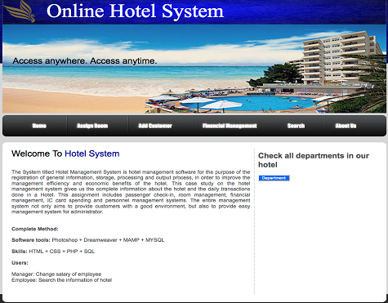

ADVANTAGE: I have designed the given proposed system in the JSP to automate the process of Hotels. This project is useful for the authorities which keep track of all the users registered in a particular state .The authority can add hotel packages, room details, availability of rooms, online booking etc. The following steps that give the detailed information of the need of proposed system are: Performance: During past several decades, the records are supposed to be manually handled for all activities. The manual handling of the record is time consuming and highly prone to error. To improve the performance of the Hotel Management System, the computerized system is to be undertaken. Efficiency: The basic need of this website is efficiency. The website should be efficient so that whenever a new user submits his/her details the website is updated automatically. Control: The complete control of the project is under the hands of authorized person who has the password to access this project and illegal access is not supposed to deal with. All the control is under the administrator and the other members have the rights to just see the records not to change any transaction or entry. Security: Security is the main criteria for the proposed system. Since illegal access may corrupt the database. So security has to be given in This Project.
Scope of Future Application
This project can be used in the hotel after adding some more useful modules in the project for which hotel are providing services. Utmost care and back-up procedures must be established to ensure 100% successful implementation of the computerized hotel system. In case of system failure, the organization should be in a position to process the transaction with another organization or if the worst comes to the worst, it should be in a position to complete it manually.

Slide 9
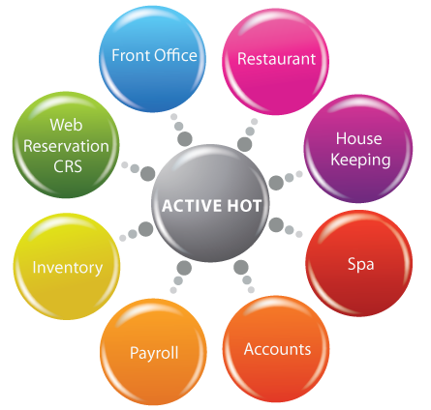

Slide 10
ADVANTAGE: This project is useful for the authorities which keep track of all the users registered in a particular state. Performance: During past several decades, the records are supposed to be manually handled for all activities. The manual handling of the record is time consuming and highly prone to error. Efficiency: The basic need of this website is efficiency. The website should be efficient so that whenever a new user submits his/her details the website is updated automatically. Control: The complete control of the project is under the hands of authorized person who has the password to access this project and illegal access is not supposed to deal with.. Security: Security is the main criteria for the proposed system. Since illegal access may corrupt the database. So security has to be given in This Project.

Slide 11
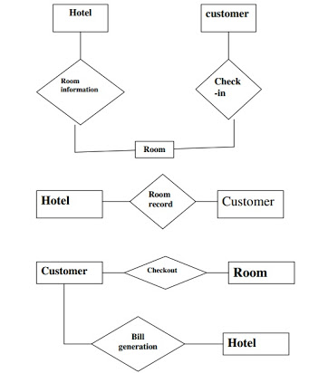
ER-Diagram

Slide 12
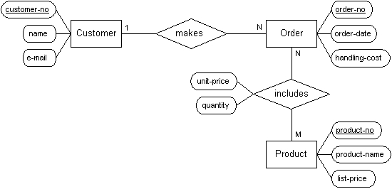

Slide 13
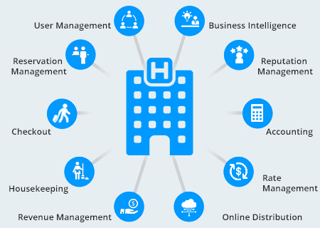
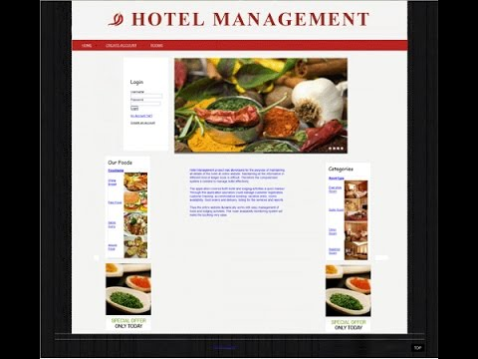
GALLERY

Slide 14
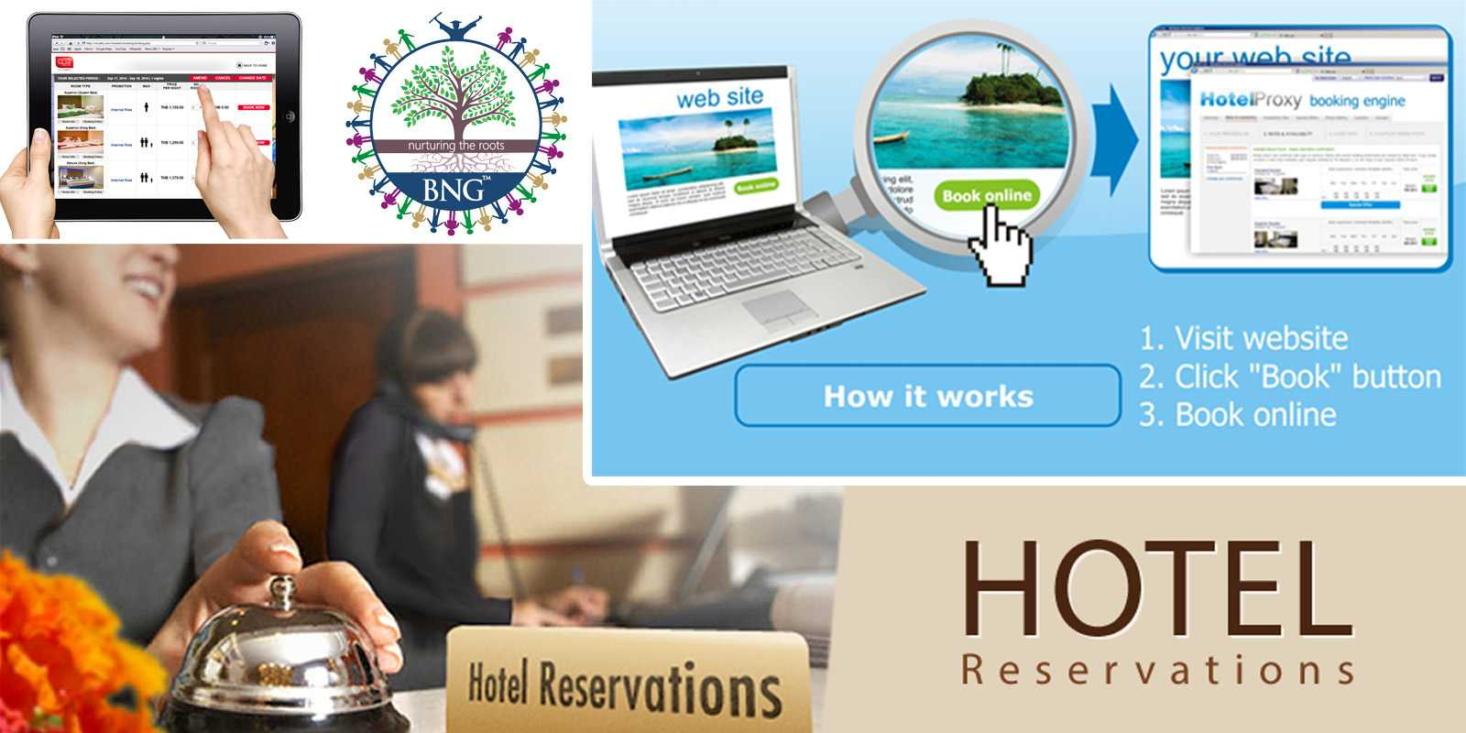

Slide 15
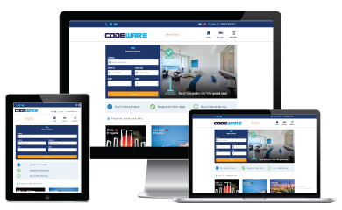
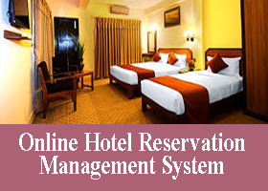
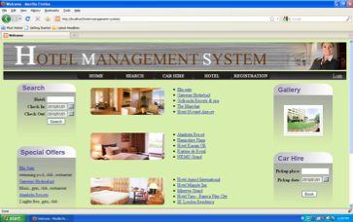

Slide 16
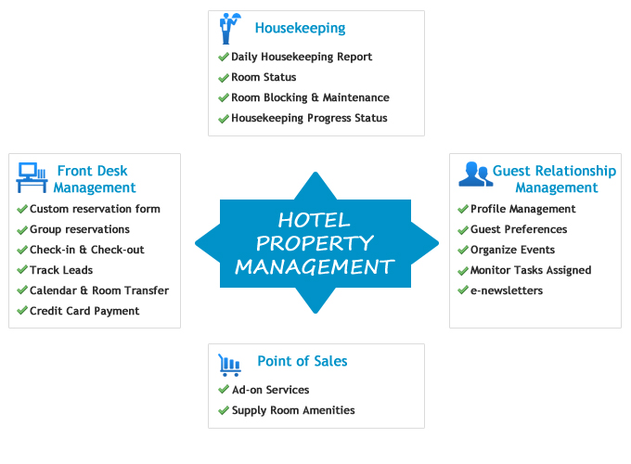

Slide 17
Function Details The basic objective of HOTEL MANAGEMENT SYSTEM is to generalize and simplify the monthly or day to day activities of Hotel like Room activities, Check in of New Customer, Check out of customer, Assigning a room according to customer requirement, and finally compute the bill etc. which has to be performed repeatedly on regular basis. Let us now discuss how different functions handle the structure and data files: 1. Password In this module, this website is for multiple users. If a User enters a password and the software checks its validity. If the password is valid then option is given to change the password, otherwise “Invalid User/Password” message is displayed. 2 Creating new Entity (Hotel, Room, Customers,Members etc.) This is used to add a new employee details, delete entity details and view the details. In this function, whenever a new entity is required to be added the corresponding forms are opened and the database is manipulated

Slide 18
3.Function NEW_ROOM() This is the function used to open a new room for a customer so that he/she can assign a separate room. 4.Function CHECKIN_CUSTOMER() This function is used to admit a customer in our Hotel after entering his all personal details like Name, Address, Phone, Sex and then he/she is assigned a room from NEW_ROOM() function. 5.Function CHECKOUT_CUSTOMER() This unction is used to checkout the customer details from database. 6. Function GENERATE_BILL() When any customer check-out, his/her bill is generated automatically by calculated check-out date minus check-in date and getting multiplied it by daily room charge plus other charges and the bill has to be saved in the table in the database. 7.Function DISPLAY_RECORD() This function is used to display all the transaction including the customer name, address, phone, bed number, and doctor assigned to him/her in the screen.

Slide 19
8 Validation of Data Entered by the User & Error Handling In this function, the validity of data entered by the user during the various business processes is checked through various validation checks. 10 Searching In this function, room, customer well as members can search details from the database according to their authentications. 11: Report Generation In this function reports are generated for the following entities: a) Customer Details. b) Requirements of the Customers c) Rooms Details d) Bill Details e) Checkin Reports f) Booking Details g) Online Bookings h) Checkout Details i) Membership Details j) Packages Available.

Slide 20
CONCLUSION This project is designed to meet the requirements of Online Hotel Management. It has been developed in JSP, Servlets keeping in mind the specifications of the system. For designing the system we have used simple data flow diagrams. Overall the project teaches us the essential skills like: Using system analysis and design techniques like data flow diagram in designing the system. Understanding the database handling and query processing.

Slide 21
Bibliography JAVA Programming E.Balagurusamyl JAVA Projects Tony Martin,Dominic Selly MY SQL The Complete Reference George Koch

Slide 22
THANK YOU

